Slide 1


ADVANCE FARMING WITH AUTOMATION
Vivek Agarwal
ECE B, 2nd Year,11500319027

Slide 2
INTRODUCTION
This project is designed and developed to integrate IOT with the Real time Farming lands and promote more and more agriculture growth in India. The old methods were good, but increasing population needs Growth and Development, and People are getting source of Internet and other Platforms, they should be able to control and check Realtime database over the internet.
The Old Security Doll Won’t help anymore, need to upgrade in every way. Our Projects Promote this movement and Further improvements in future will lead to a great start.

Slide 3
CONTENTS
Small Presentation
Components Used (Hardware + Software)
Working
Block Diagram
Circuit Diagram
Code Implementation
Advantages and Disadvantages
Future Improvements
Price chart
Final Presentation

Slide 4
Components Used
Hardware
Soil Moisture Sensor
Relay Module
LCD panel (16*2)
DTH11 Sensor (Temp/Hum)
NodeMCU (Brain)
Led/Buzzer/Fan/Pump motor/Battery
2. Software
Google Firebase
ThingSpeak
MIT App Inventor
Arduino IDE

Slide 5

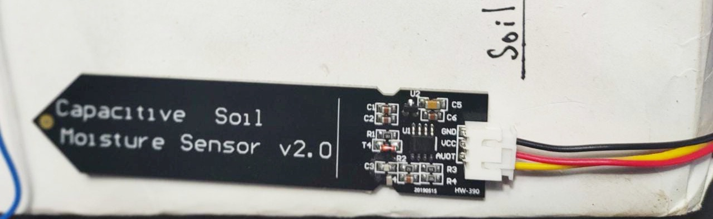
Soil Moisture Sensor
The soil moisture sensor (SMS) is a sensor connected to an irrigation system controller that measures soil moisture content in the active root zone before each scheduled irrigation event and bypasses the cycle if soil moisture is above a user- defined set point.
A capacitive moisture sensor works by measuring the changes in capacitance caused by the changes in the dielectric. Capacitive measuring basically measures the dielectric that is formed by the soil and the water is the most important factor that affects the dielectric.

Slide 6
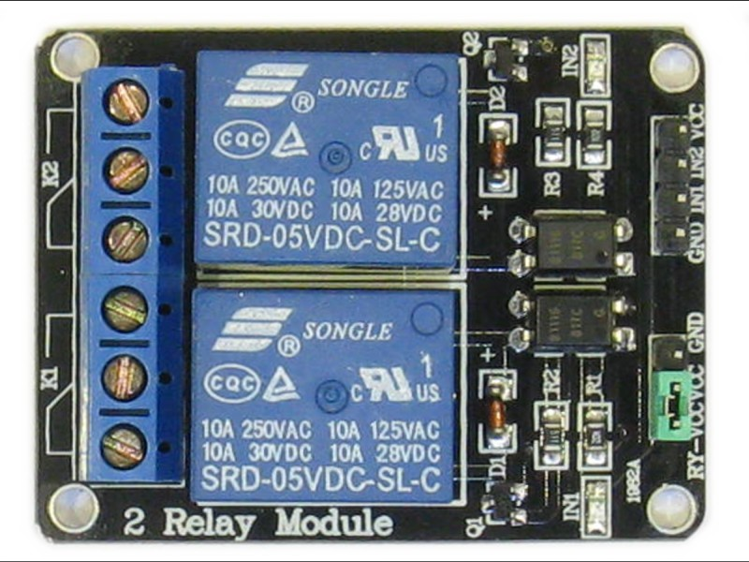
RELAY MODULE
5V Two Channel Relay
This module contains two relays that are electrically isolated from the controlling input. The relays can be used to switch higher voltage and current loads than a microcontroller can traditionally accomplish.

Slide 7
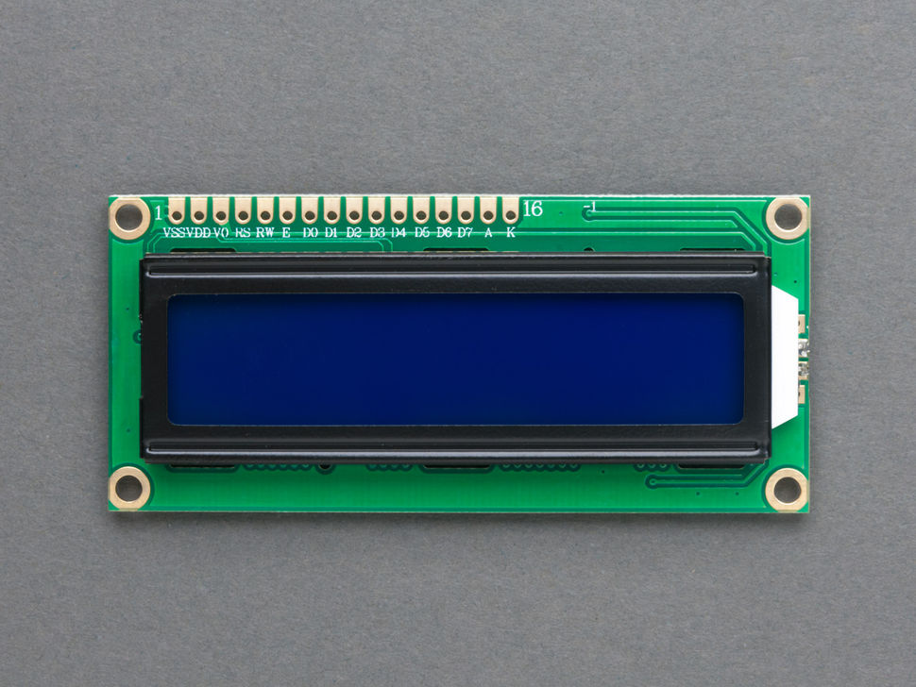
LCD PANEL (16*2)
An LCD (Liquid Crystal Display) screen is an electronic display module and has a wide range of applications. A 16x2 LCD display is very basic module and is very commonly used in various devices and circuits. A 16x2 LCD means it can display 16 characters per line and there are
2 such lines. In this LCD each character is displayed in 5x7 pixel matrix. The 16 x 2 intelligent alphanumeric dot matrix display is capable of displaying 224 different characters and symbols. This LCD has two registers, namely, Command and Data.

Slide 8
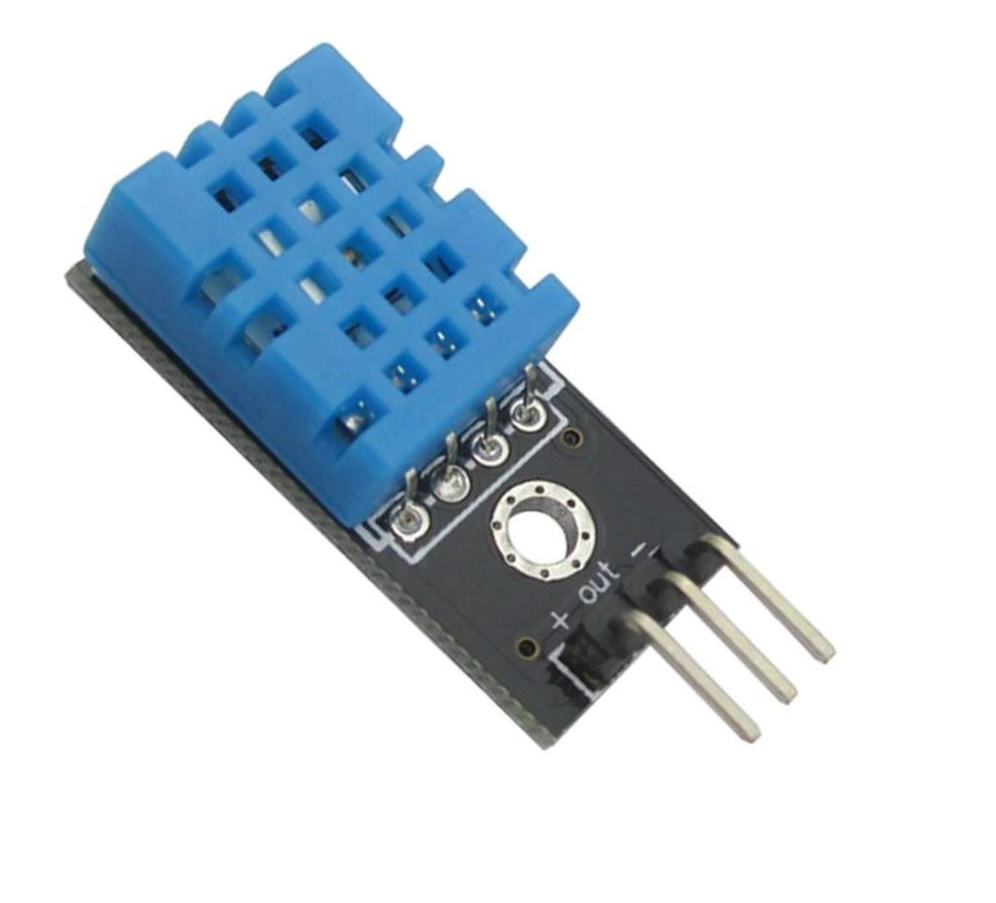
DTH 11 SENSOR
The DHT11 is a basic, ultra low-cost digital temperature and humidity sensor. It uses a capacitive humidity sensor and a thermistor to measure the surrounding air, and spits out a digital signal on the data pin (no analog input pins needed). Its fairly simple to use, but requires careful timing to grab data.

Slide 9
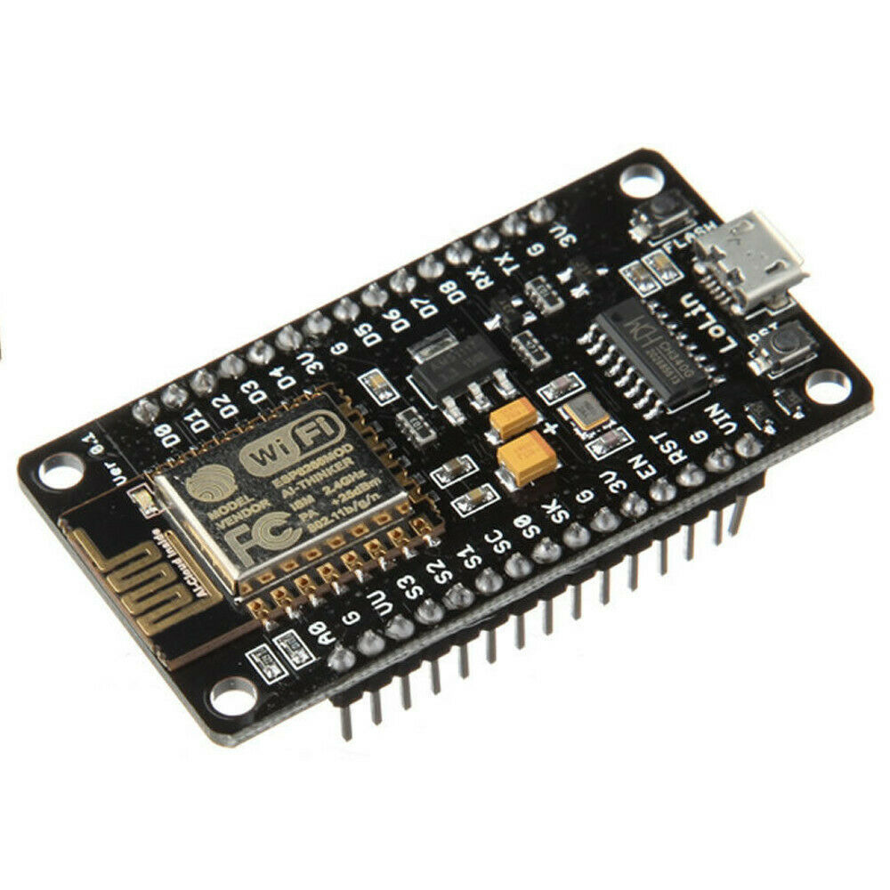
NODE MCU
The NodeMCU (Node MicroController Unit)
is an open-source software and hardware development environment built around an inexpensive System-on-a-Chip (SoC) called the ESP8266(wifi). The ESP8266, designed and manufactured by Espressif Systems, contains the crucial elements of a computer: CPU, RAM, networking (WiFi), and even a modern operating system and SDK. That makes it an excellent choice for the Internet of Things (IoT) projects of all kinds.

Slide 10

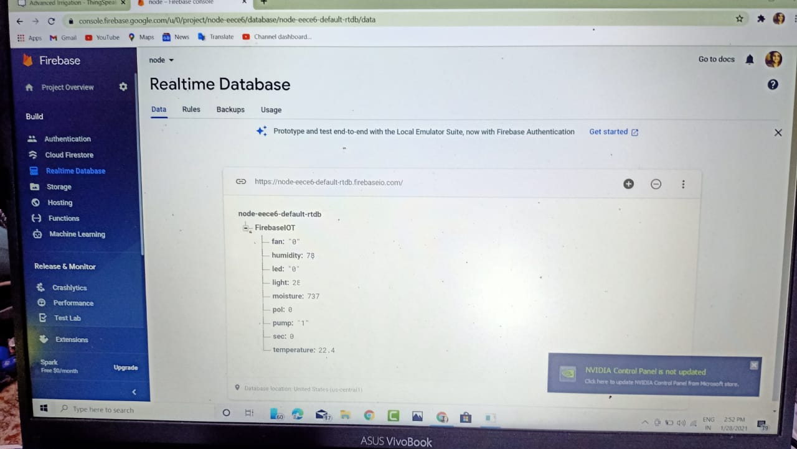
GOOGLE FIREBASE
Firebase is a platform developed by Google for creating mobile and web applications.
Google Firebase is a Google-backed application development software that enables developers to develop iOS, Android and Web apps. Firebase provides tools for tracking analytics, reporting and fixing app crashes, creating marketing and product experiment.

Slide 11
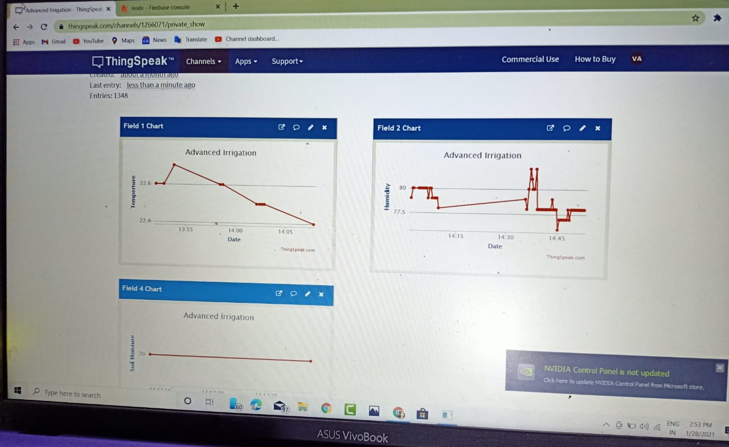
THINGSPEAK
ThingSpeak provides instant visualizations of data posted by your devices to ThingSpeak. With the ability to execute MATLAB® code in ThingSpeak you can perform online analysis and processing of the data as it comes in. ThingSpeak is often used for prototyping and proof of concept IoT systems that require analytics.

Slide 12
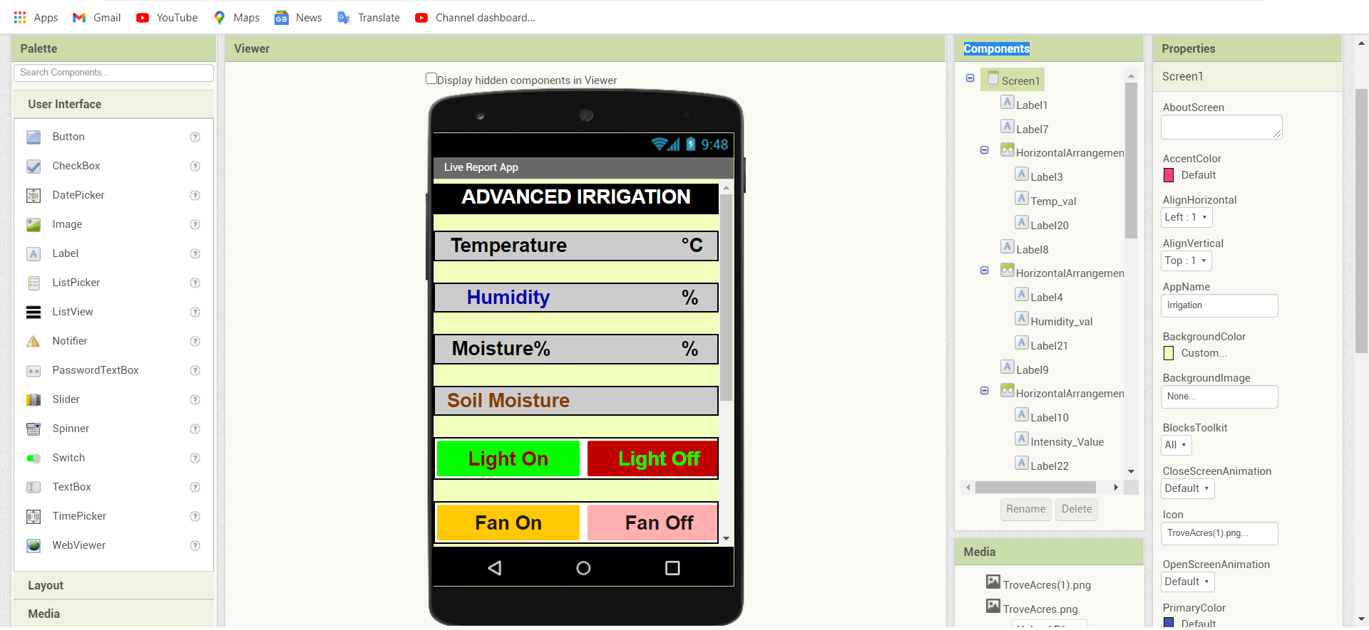
MIT App Inventor
MIT App Inventor is an intuitive, visual programming environment that allows everyone even children to build fully functional apps for smartphones and tablets.

Slide 13
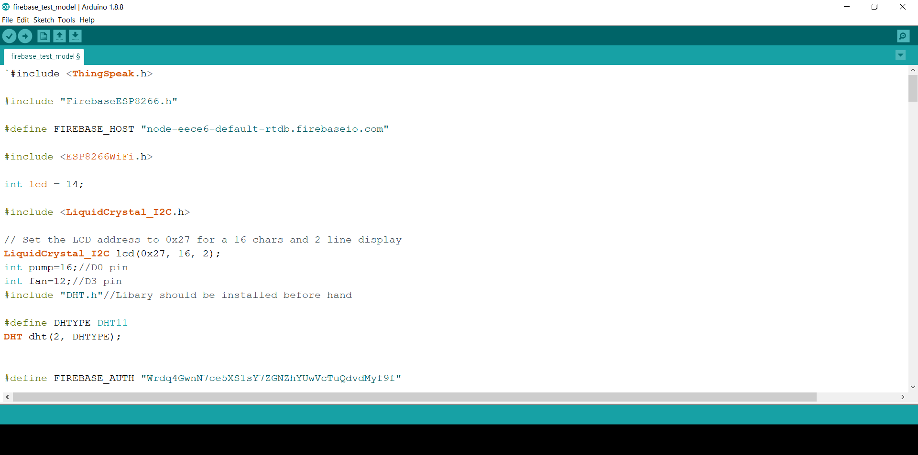
Arduino IDE
The Arduino Integrated Development Environment - or Arduino Software (IDE) - contains a text editor for writing code, a message area, a text console, a toolbar with buttons for common functions and a series of menus.

Slide 14
WORKING
The Project works on a 3 way process, at first NodeMCU takes data from sensors and stores them on Firebase with the help of internet. Then The Mobile App takes the values from the firebase, and showcase to the user. The Process works on 2 way data transfer, hence we can send values from Mobile app to the NodeMCU with the help of Firebase. We can use it for Automation and controlling over the internet, from any where in the world.
ThingSpeak is a open based MATLAB Software, where we send the data from NodeMCU and it creates graph. Which can be used for many functions and record daily data's.

Slide 15
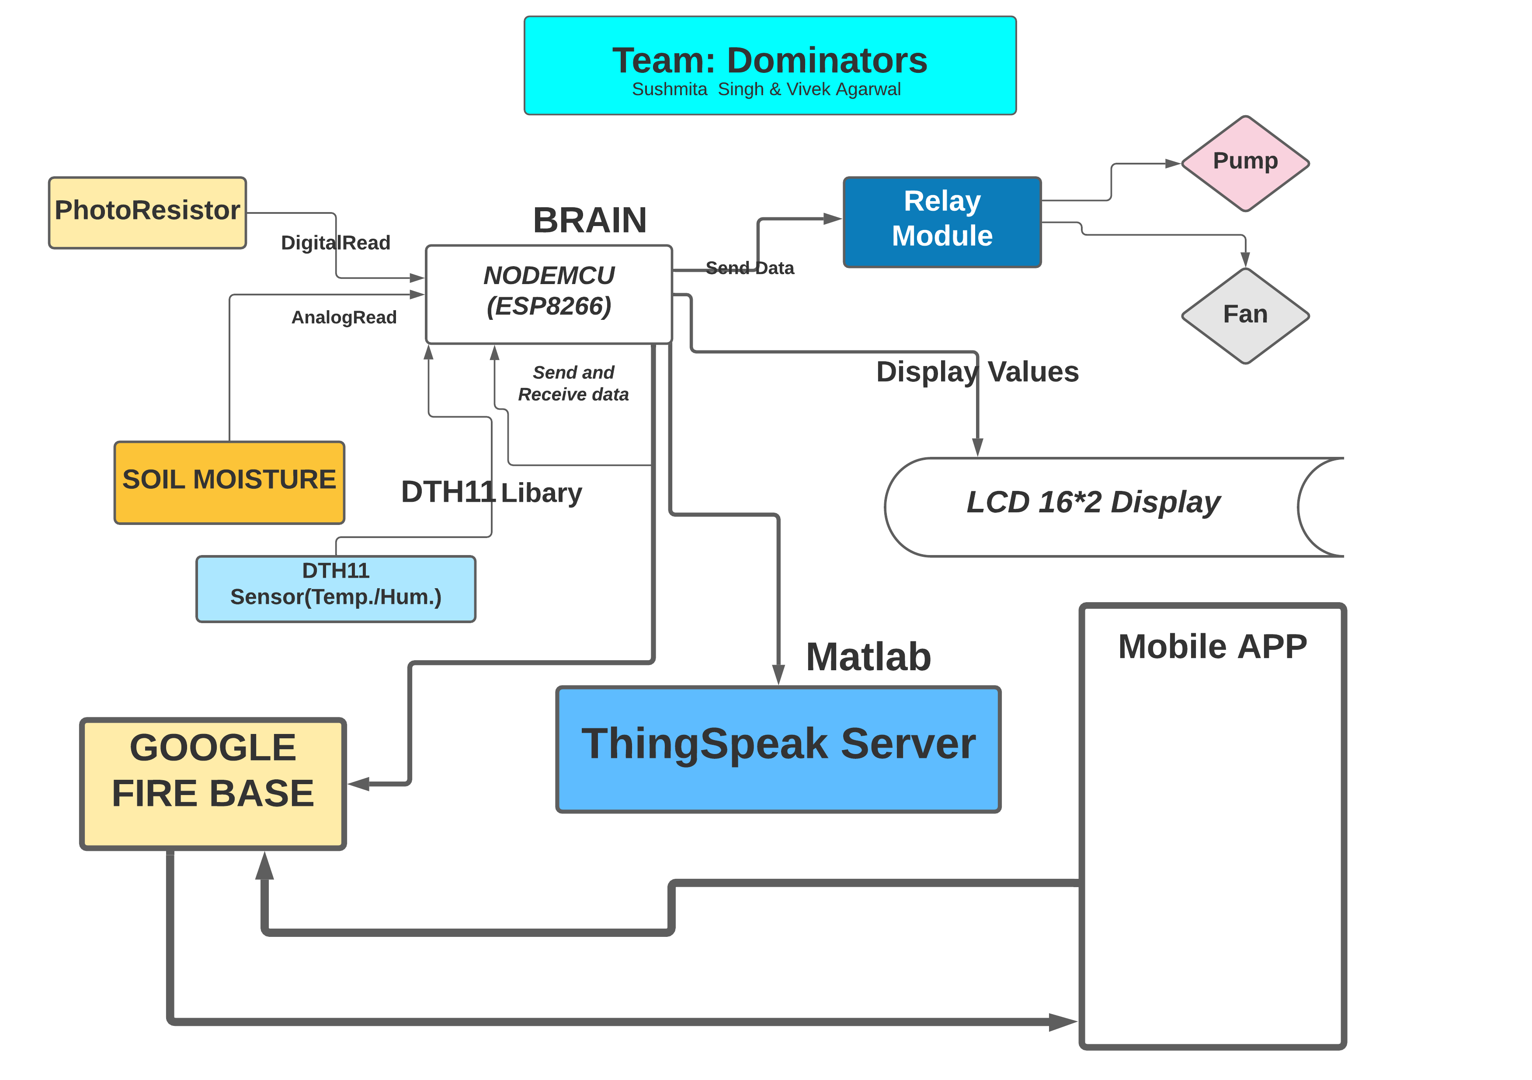
Block Diagram

Slide 16
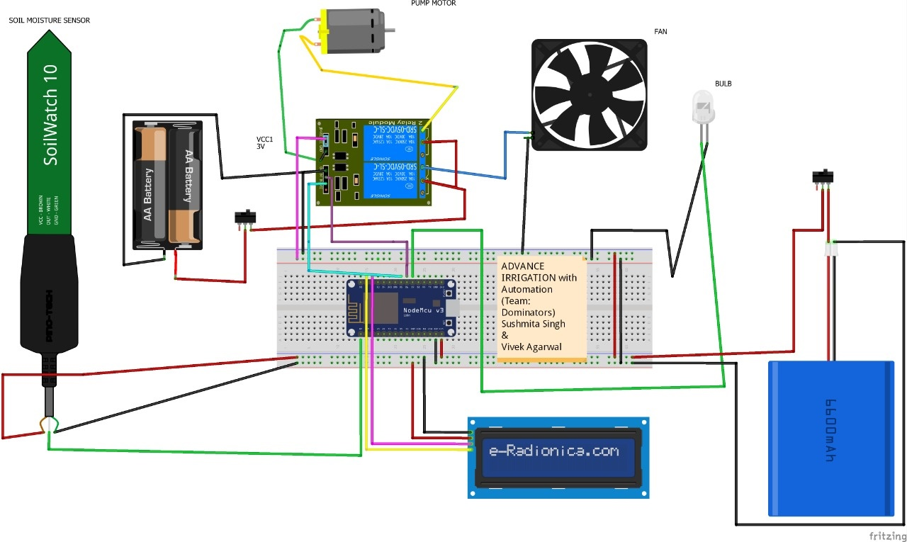
Circuit Diagram

Slide 17
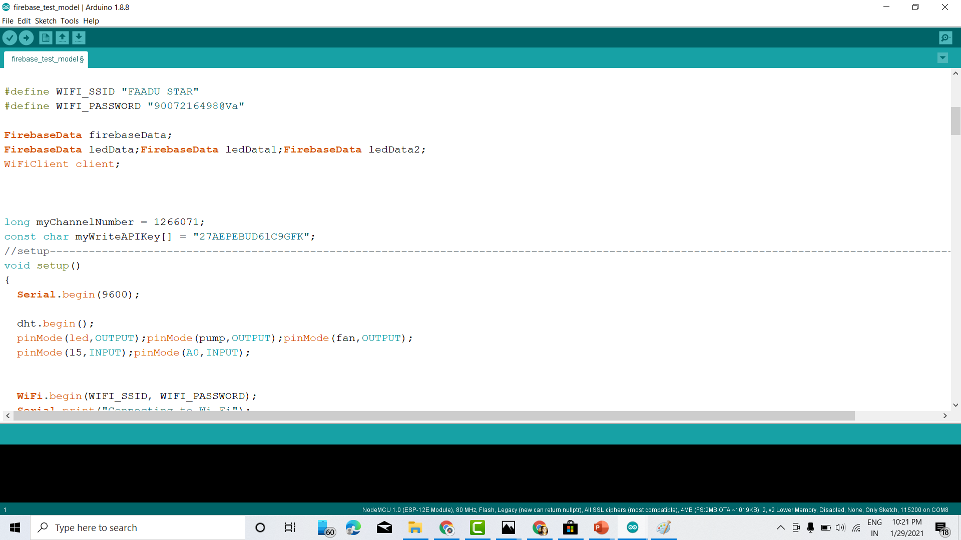
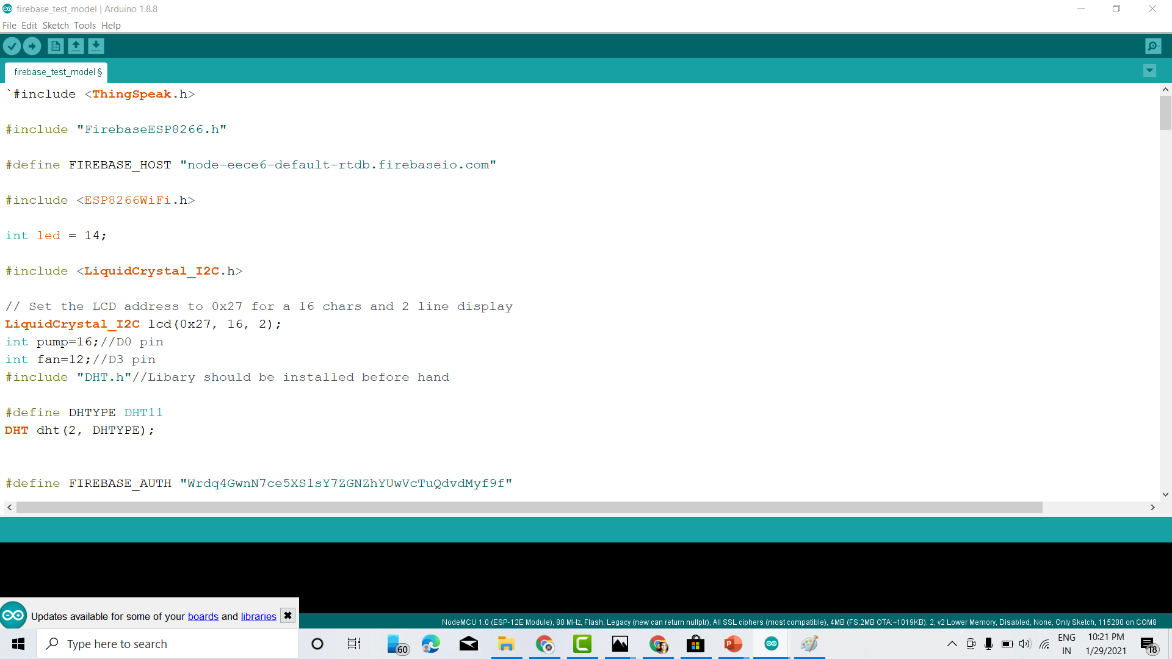
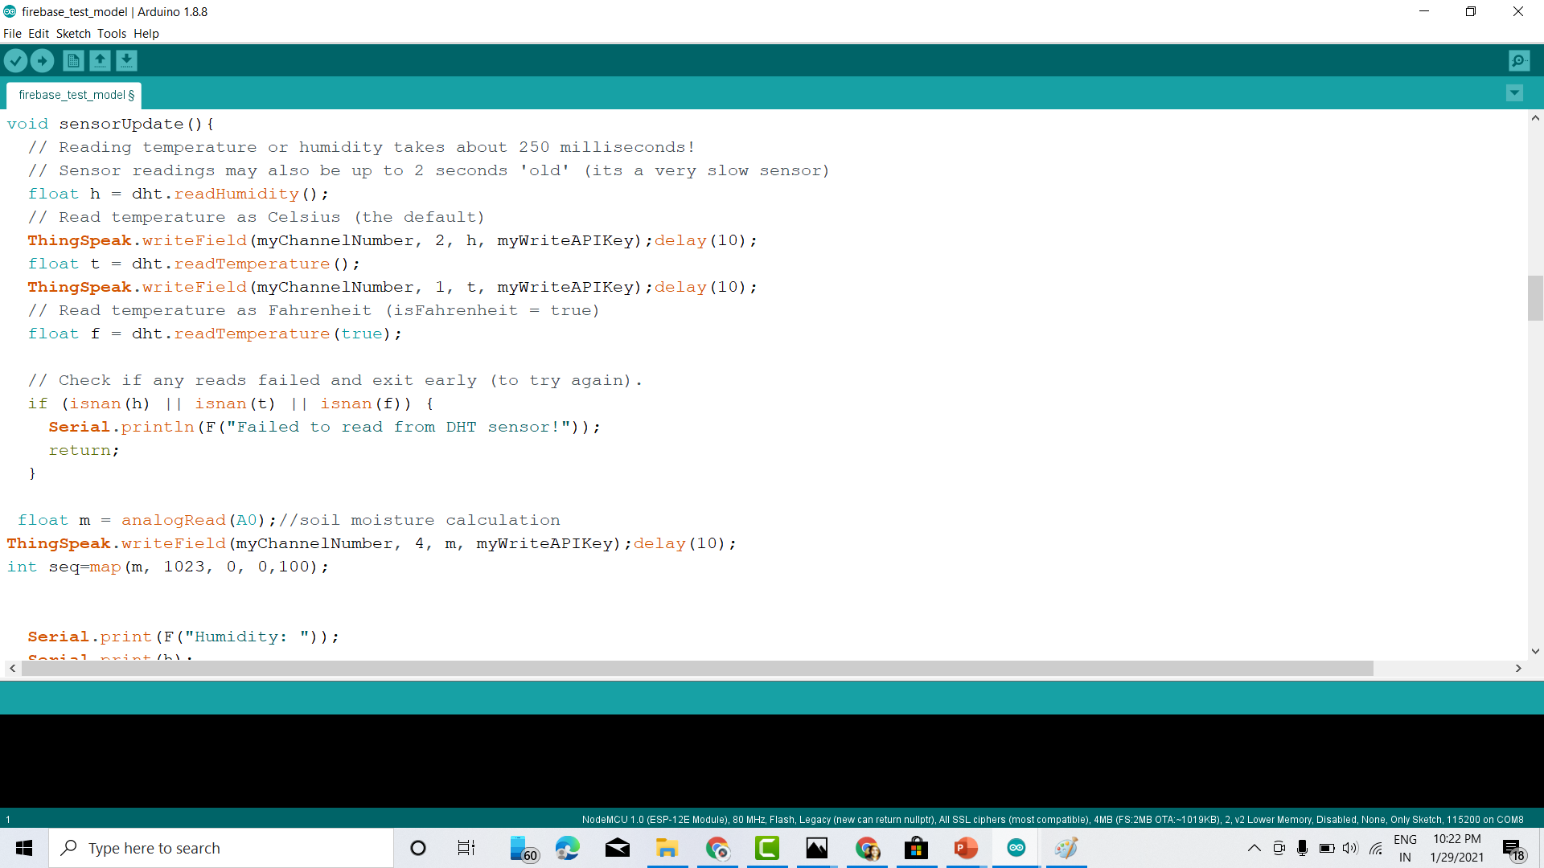
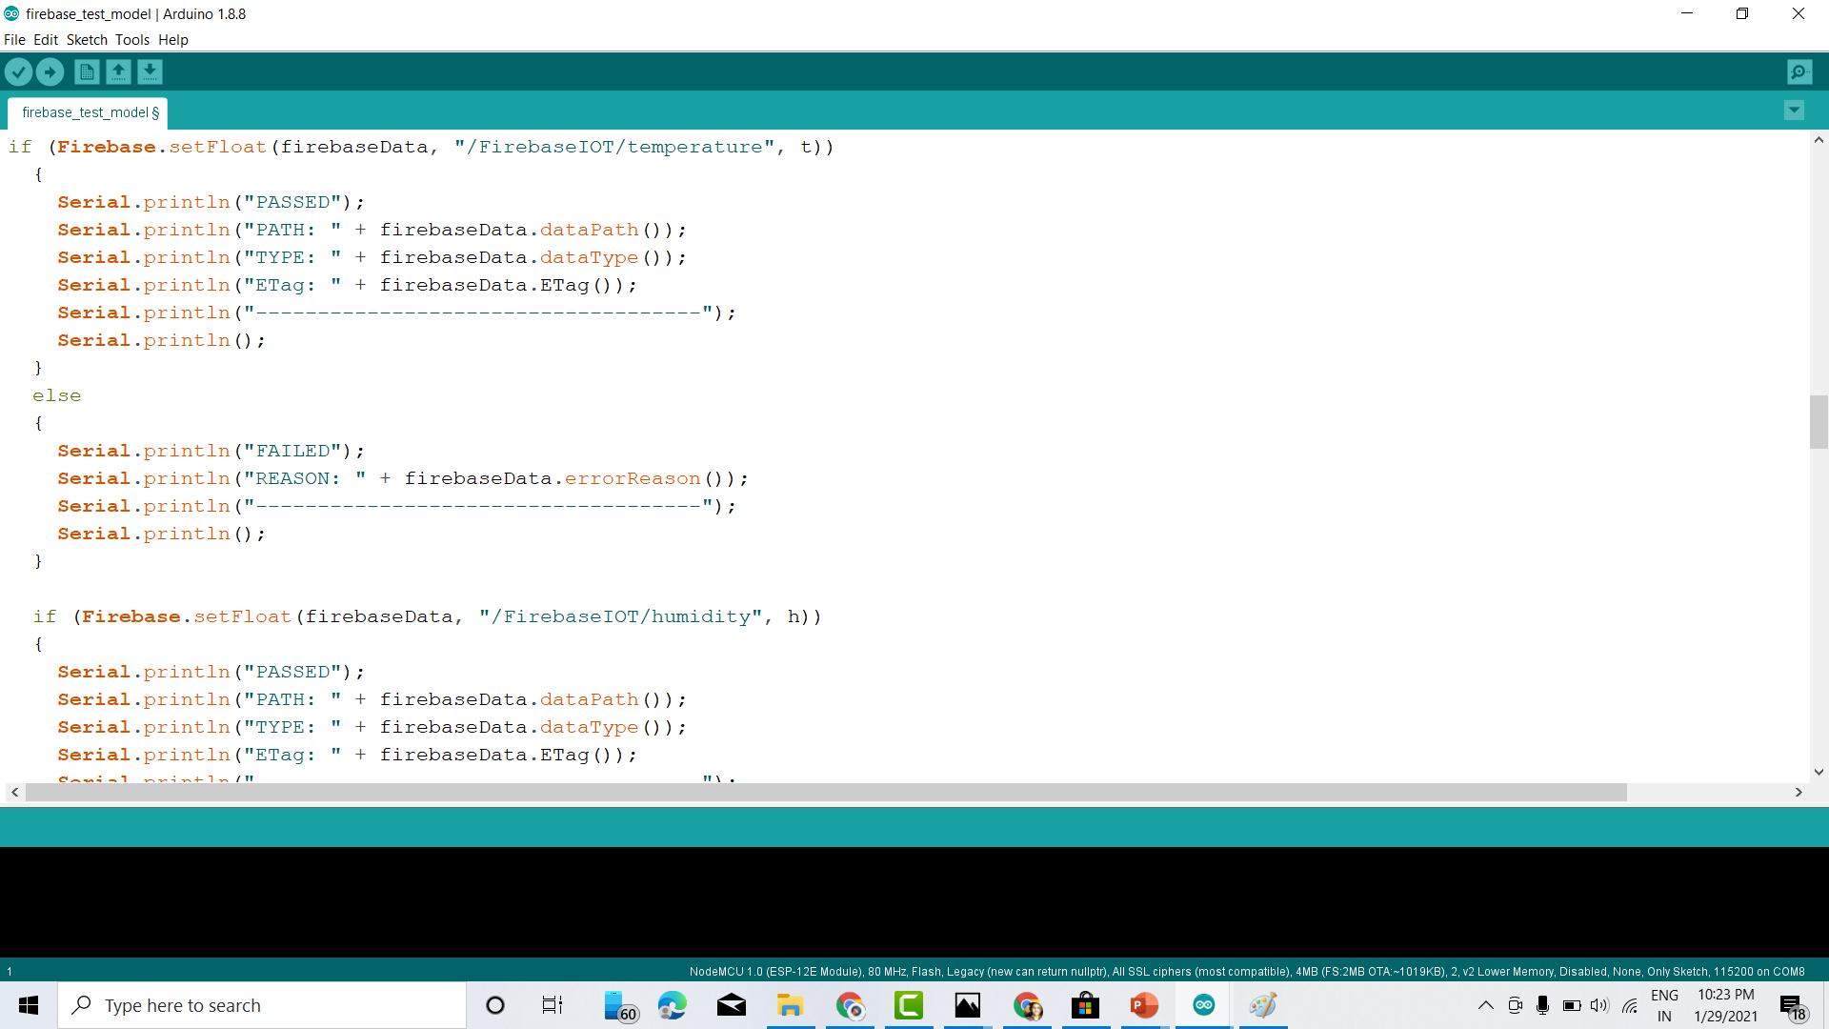
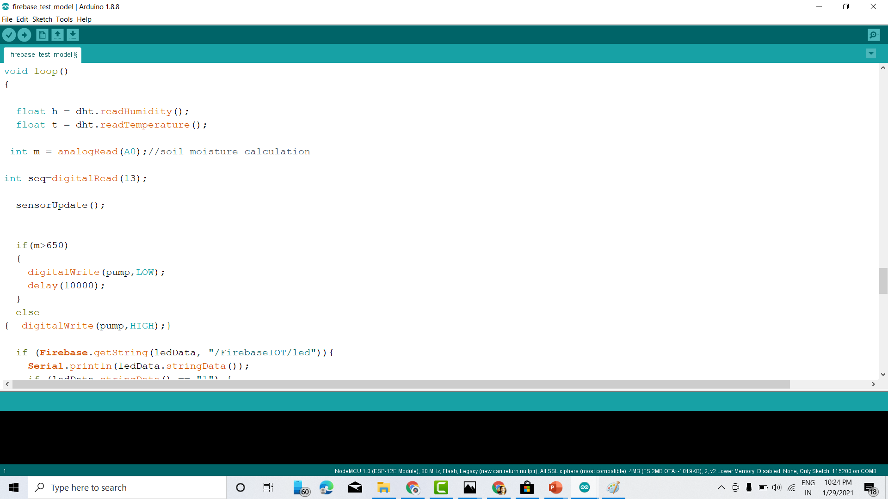
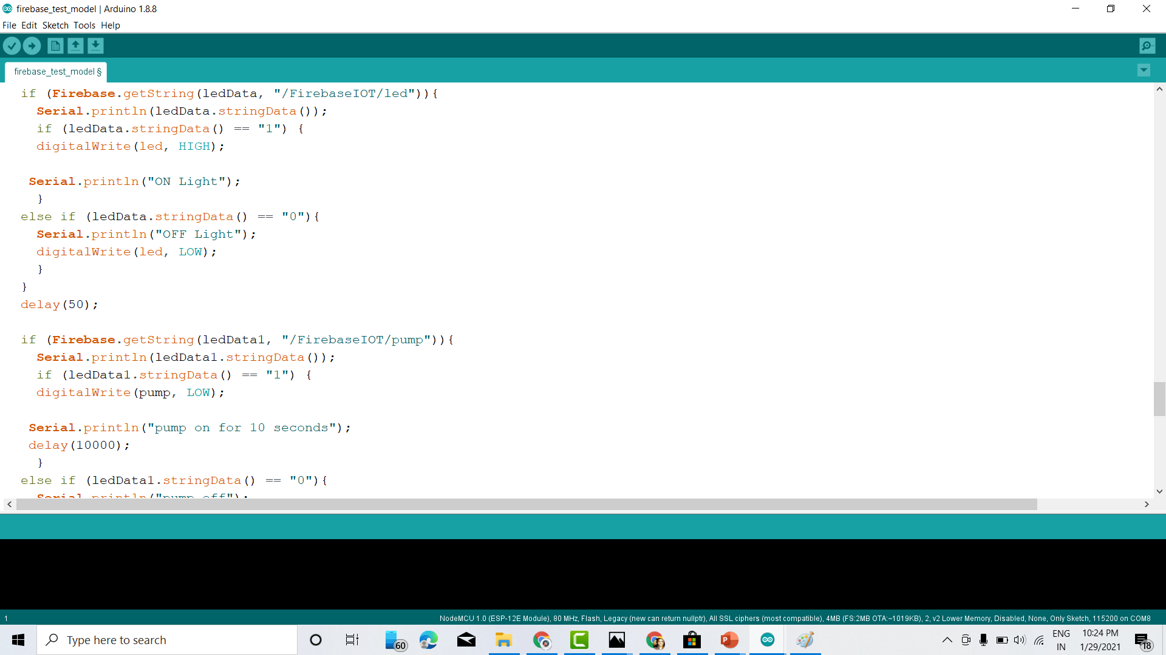
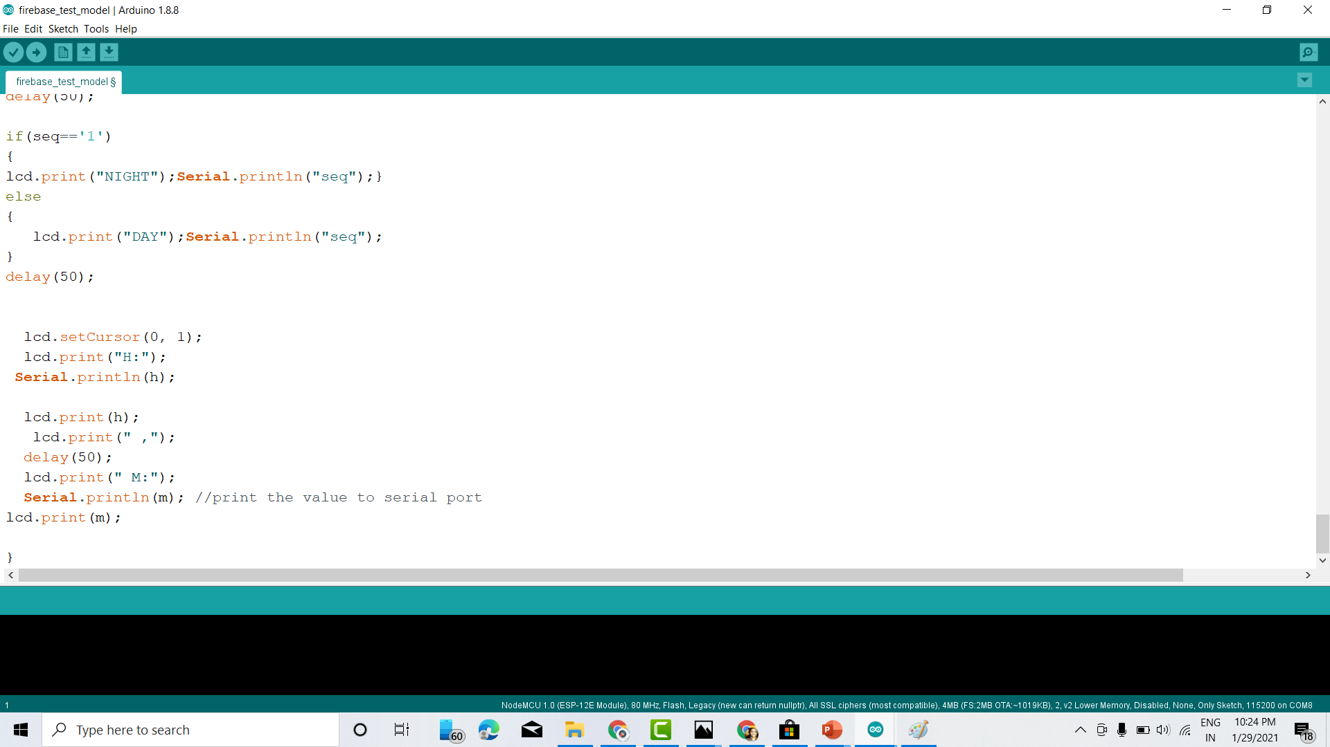
Code
We try to explain codes in Brief, because the code is complex and contains tons of lines. Thank You😊.

Slide 18
Advantages
Provides Real-time data Base to user, from anywhere in the World.
Mobile App, which can be accessed and control the device in very convenient way.
Data records later can used, to check which crops can be cultivated in which season. Adding Machine learning kicks the growth to next level.
Security System at the Farm Land can be used for protection purpose of Farm Land.

Slide 19
Disadvantages
Needs Internet Facility to work properly, which is not present everywhere in India.
NodeMCU have only one Analog pin, hence only one Sensor can Read Values. Adding more decreases the functionality.

Slide 20
Future Improvements
Using the Data Records, Machine Learning can used to promote more growth in Agriculture.
Adding more Sensors (Example: MQ135(air quality),light intensity etc.), increases its Functionality.
Controlling Robots and using Self Driven Tractors.
Adding Camera for more good Security purpose.

Slide 21
Effective Project Cost
Sl.No. | Component | Price
1 | DTH11 Sensor | Rs 80
2 | Soil Moisture | Rs 60
3 | NodeMCU | Rs 180
4 | LCD Panel | Rs 160
5 | Relay Module | Rs 120
6 | 5V Pump | Rs 60
7 | Led | Rs 10
8 | Battery | Rs 100
9 | 12V Fan | Rs 50
10 | Switches + Wires | Rs 50
TOTAL |  | Rs 870

Slide 22
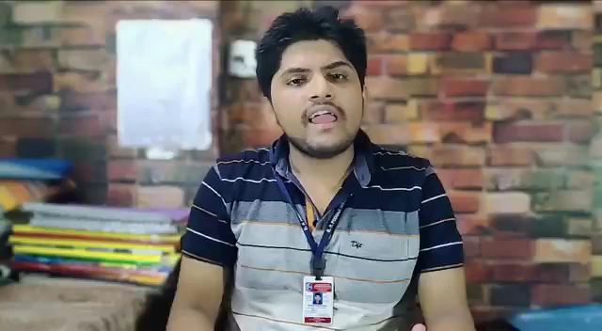
Presentation

Slide 23
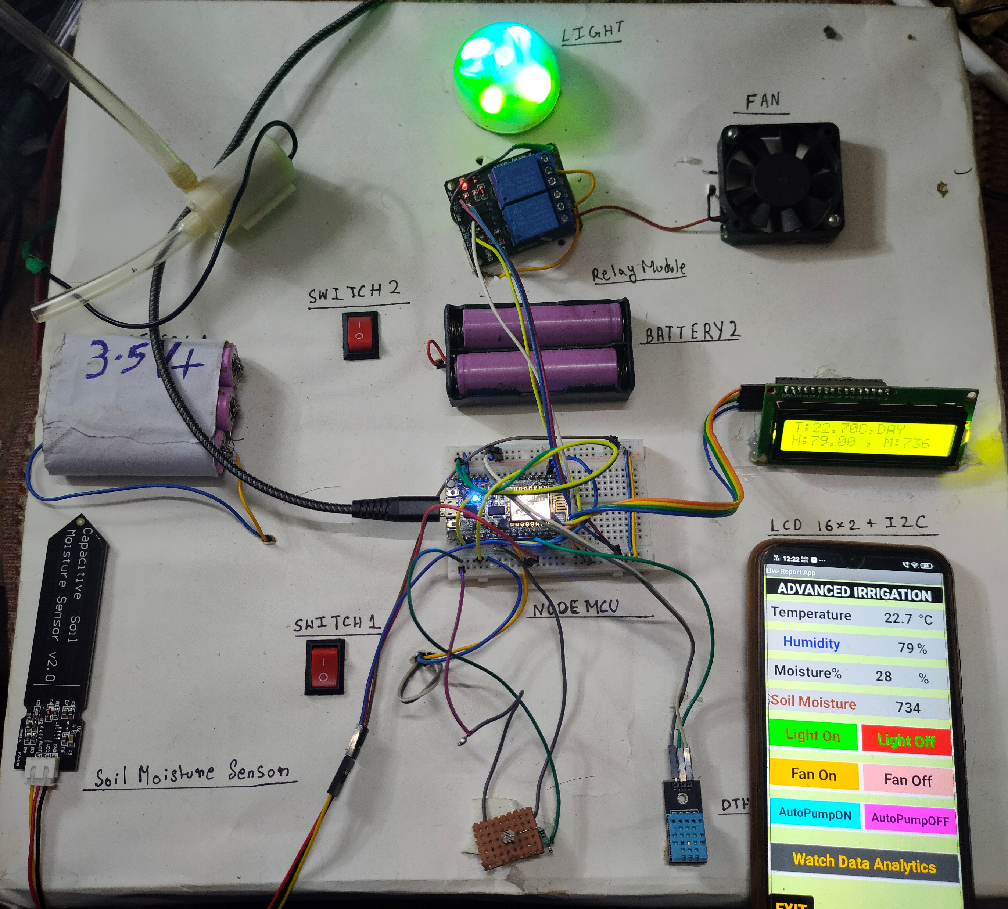
Thanks For Watching
From:
Vivek Agarwal
ECE, 2nd Year,11500319027

